Slide 1
Common Crawl - Lorelei Language Classification

Slide 2
Outline
Problem presentation
Architecture
Datasets
Common Crawl
Wikipedia
Pipeline
Presentation
Algorithms
Results

Slide 3



Problem presentation
The Common Crawl is an open repository of web crawl data collected over last 7 years.
The goal is to create a linguistic repository by categorizing the common crawl data to appropriate languages, focusing on rare languages
Images credit: Common Crawl project

Slide 4
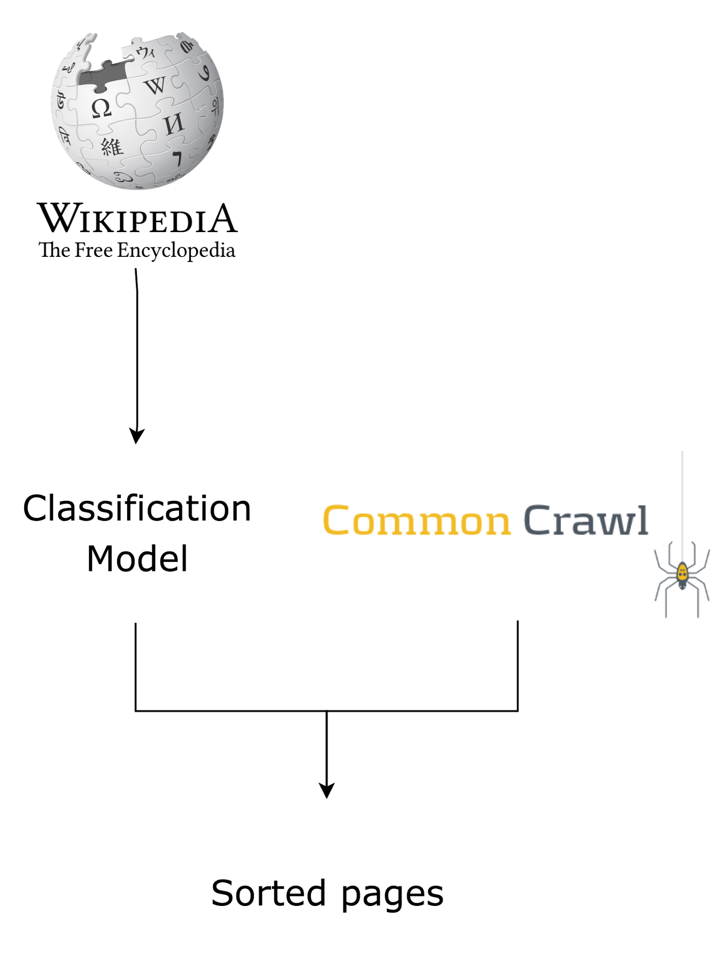
Architecture
Train the language classifier on Wikipedia data.
Process archive files in parallel: unpack, process, delete unpacked version.
When a page in a rare language (i.e. not in the top 10) is found, save its URL, plaintext and detected language on mongoDB.

Slide 5




Architecture: Technologies
Common Crawl data: stored on Amazon S3. We use Globus for data transfers.
ML pipeline: PySpark.
Storage: MongoDB ?

Slide 6
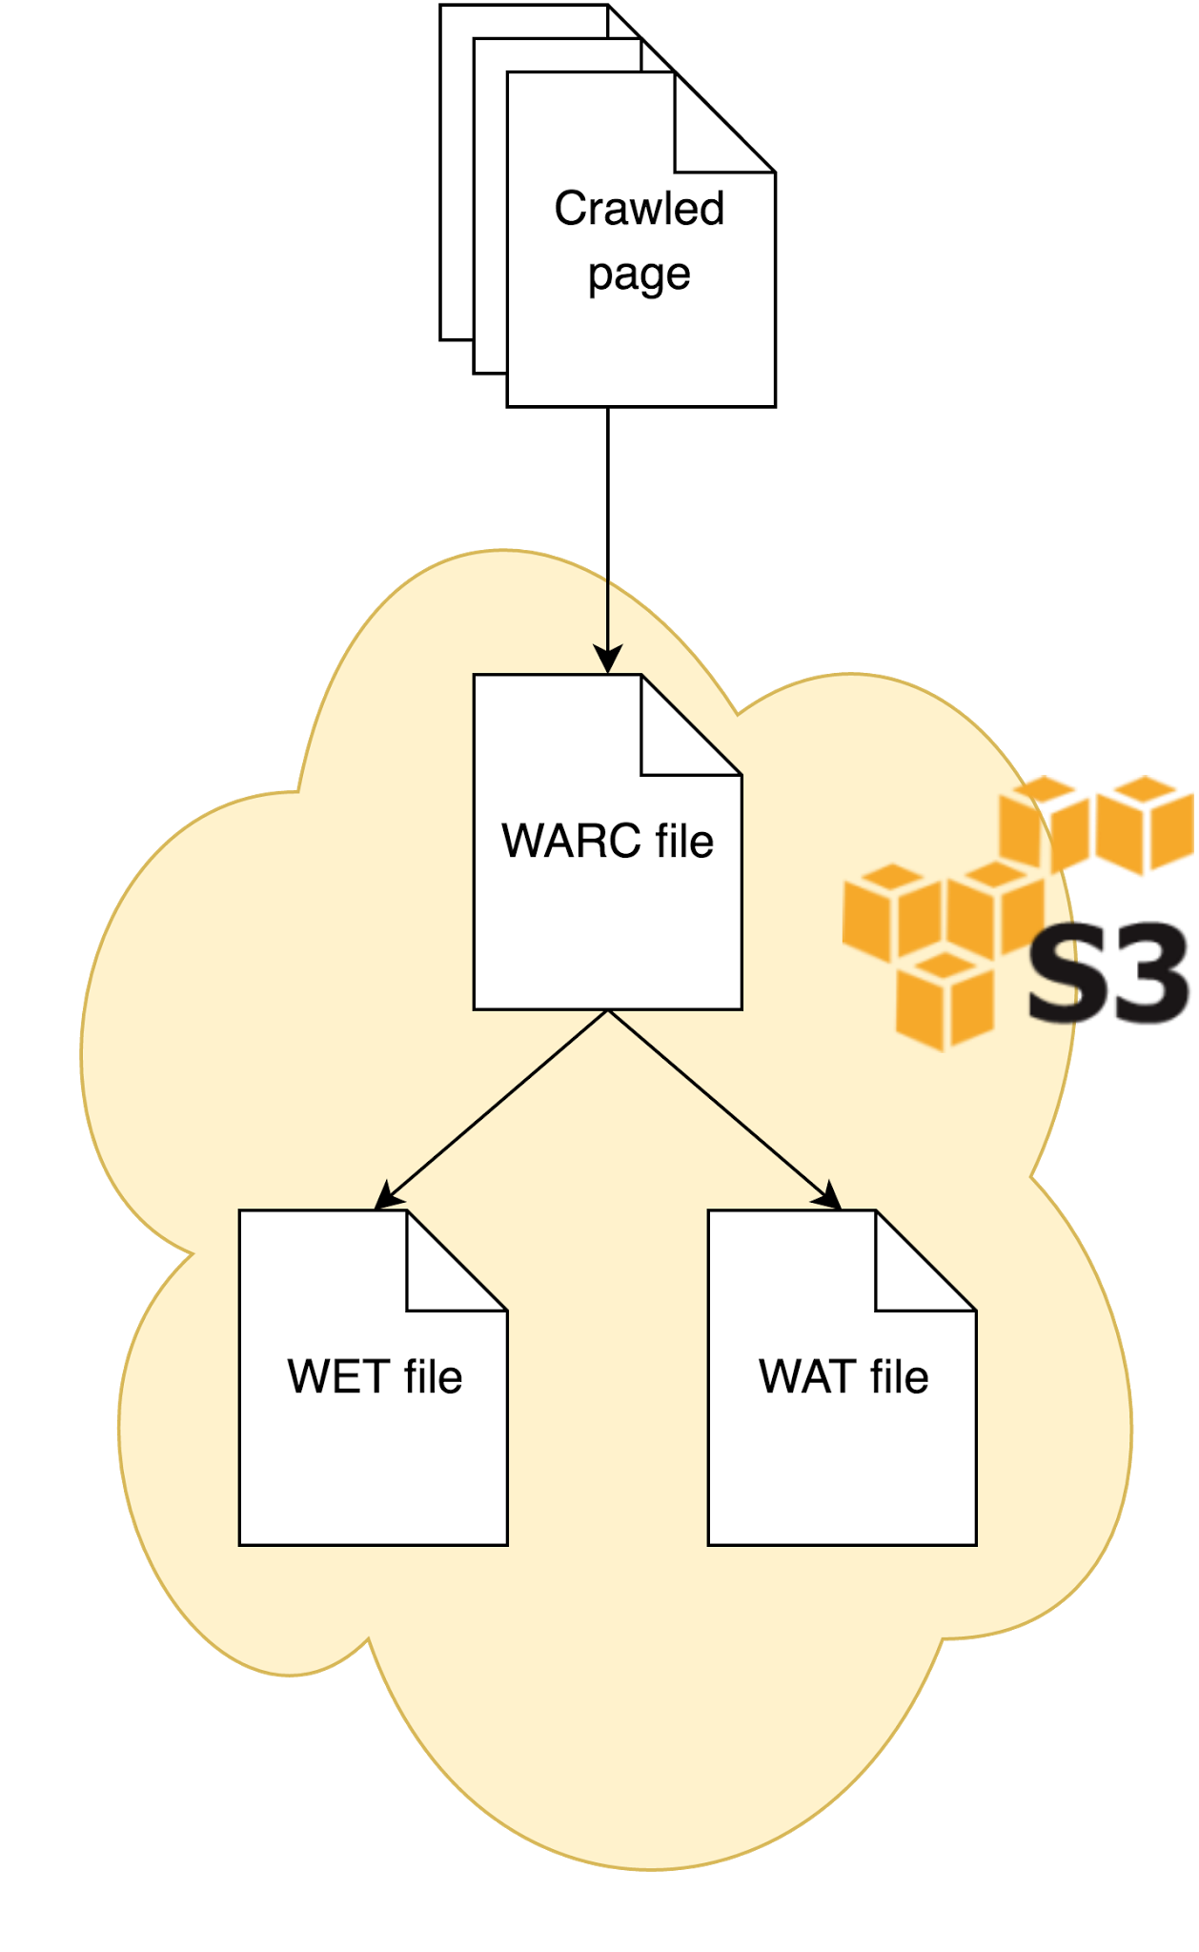
Datasets: Common Crawl file formats
Stored as gzipped archive files, with many pages in each file
3 main file formats: WARC, WAT and WET.
Notes:
WARC
Common Crawl headers (URL, date of crawl, content type,...)
Full HTTP response (headers+payload). The WARC headers are extremely easy to parse (it's a flat list of key: value pairs).
WET
Some of the Common Crawl headers
Response text only, HTML is stripped
WAT: JSON-encoded tree
Some of the Common Crawl headers
HTTP response headers
text/alt-text/url of links and images extracted from the page.

Slide 7
Datasets: Common Crawl file formats
WET contains the extracted page text, could be useful for classification.
Extraction algorithm is available online, but probably hard to implement in a Spark pipeline.
Other possibility: strip HTML ourselves.
Notes:
See wiki page at http://snowmass.lti.cs.cmu.edu/SnowCrash/downloader/wikis/file-formats for detailed information

Slide 8
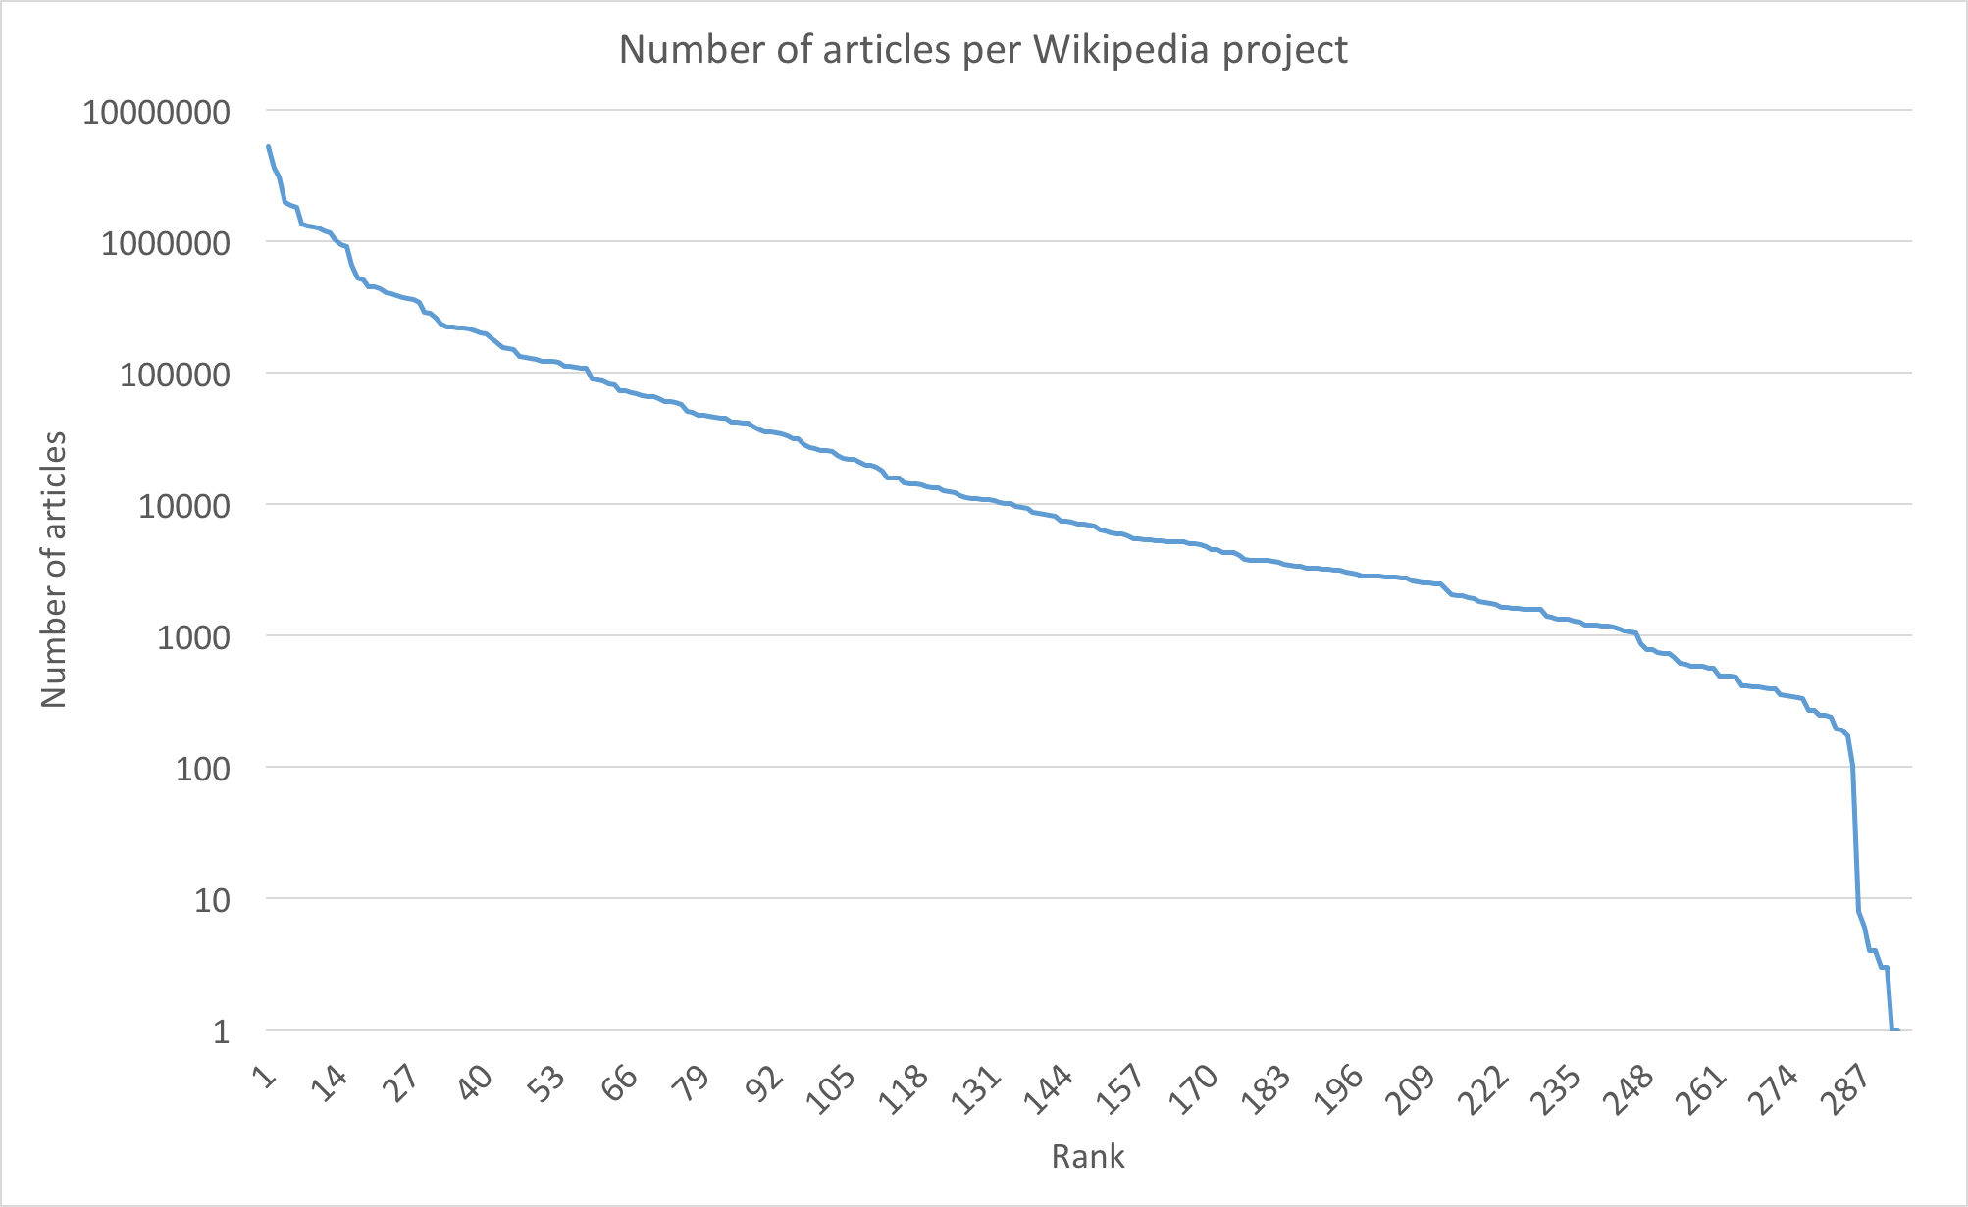
Datasets: Wikipedia
295 languages, total of 42,000,000 articles.
Sizes vary:
49 Wikipedias under 1,000 articles
112 between 1,000 and 10,000 articles
Notes:
Again more information on the wiki: http://snowmass.lti.cs.cmu.edu/SnowCrash/downloader/wikis/lorelei-pipeline

Slide 9
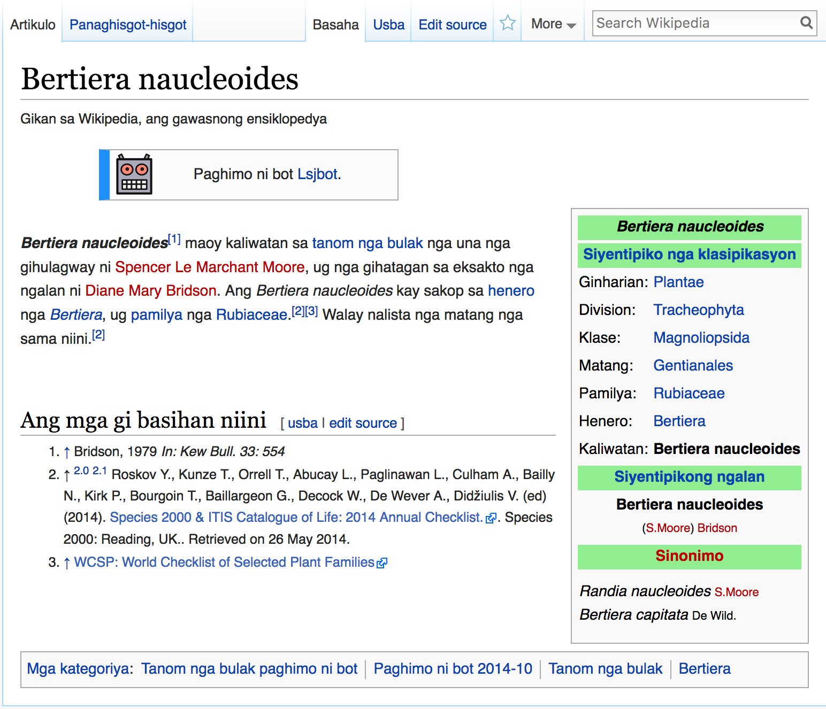
Datasets: Wikipedia
Quality also varies
Some editions are mostly bot-generated articles, e.g.
Plant and animal articles from templates+standardized databases
Machine-translated pages
Some editions have many articles, but mostly very short stubs.
Typical bot-generated page on the Cebuano Wikipedia
Notes:
The Cebuano Wikipedia is a typical example. It’s the third-largest with over 3M articles, but over 50% are stubs and it only has 114 active users (vs upwards of 100k for English, and many much smaller editions have more than 10k active users).

Slide 10
Datasets: Wikipedia
Available as regularly-updated database dumps.
Total size of the compressed dumps for all 295 languages is 53GB, or about 264GB of uncompressed XML data.
The pages are in Wikicode (a markup language), we use an external script to strip the markup and turn the dumps into (almost) plain text files.

Slide 11
Pipeline
Data retrieval and preprocessing using custom Bash+Python scripts
Actual classification implemented in pySpark
Basic pipeline:
Tokenizer -> CountVectorizer -> NaiveBayes

Slide 12
Pipeline: Algorithms
Naive Bayes on unigrams gives good performance
Probably due to the fact that different languages have few words in common
Requires a lot of memory because there are a lot of different words across all languages.
Contrary to normal document classification, Heap’s law doesn’t apply.
No IDF term used

Slide 13
Pipeline: Algorithms
Naive Bayes on bigrams
Significantly longer, uses much more memory
Not a very significant performance improvement
Also probably due to the fact that most of the information is already available from the unigrams.
Decision Tree
We weren’t able to train one for lack of RAM

Slide 14
Pipeline: Algorithms
Naive Bayes on letter trigrams
Avoids the problem of having an enormous vocabulary
Fast training with reasonably small memory use
Terrible results

Slide 15
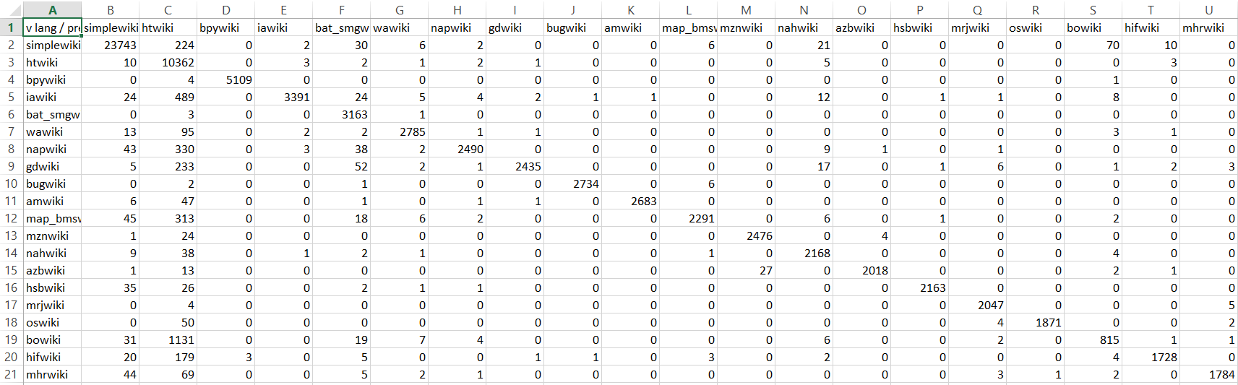
Results
Confusion Matrix: Diagonal elements are correctly predicted languages (true positives)
Overall Accuracy: 90.84%

Slide 16
Results
F1 Measure: In case of binary classification, it is the equally weighted harmonic mean of Precision and Recall.
In case of multiclass classification problems, assuming that we have a one vs all classifier, we can compute 2 types of metrics: Micro-averaged and Macro-averaged.
Macro-averaged F1 score is preferred to understand the classifier’s performance for rare languages as it gives equal weights to all the classes performance.
Here precision (macro) = 0.970, recall (macro) = 0.835 (calculated as average of the precision and recall of all the classes)
F1- Score (Macro averaged) = 0.897 (Ranges from 0-1)

